Slide 1
Reduction of Multiple Subsystems
Chapter V : Norman S Nise.

Slide 2
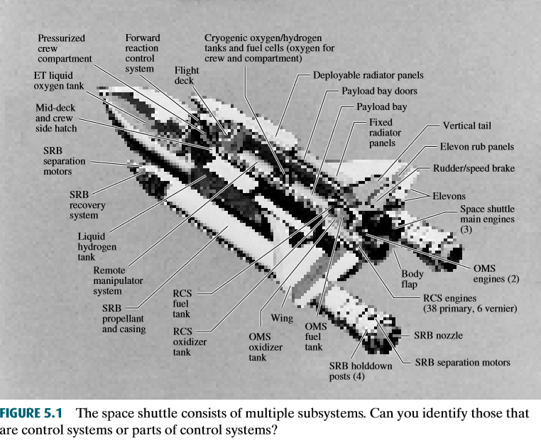
Introduction
We have been working with individual subsystems represented by a block with its input and output. More complicated systems, however, are represented by the interconnection of many subsystems.

Slide 3
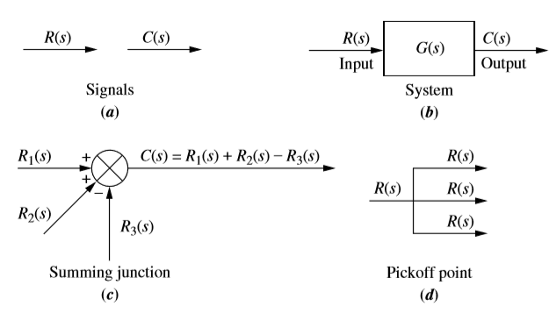
Components of a block diagram

Slide 4
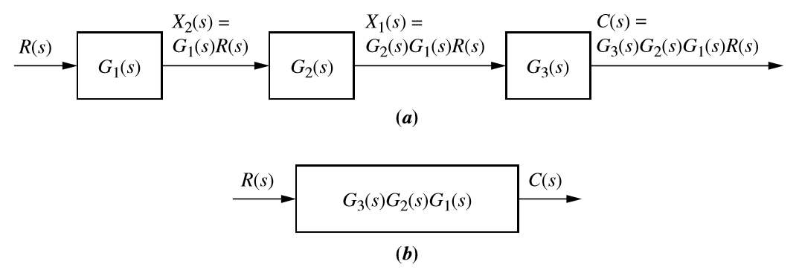
Cascade Form

Slide 5
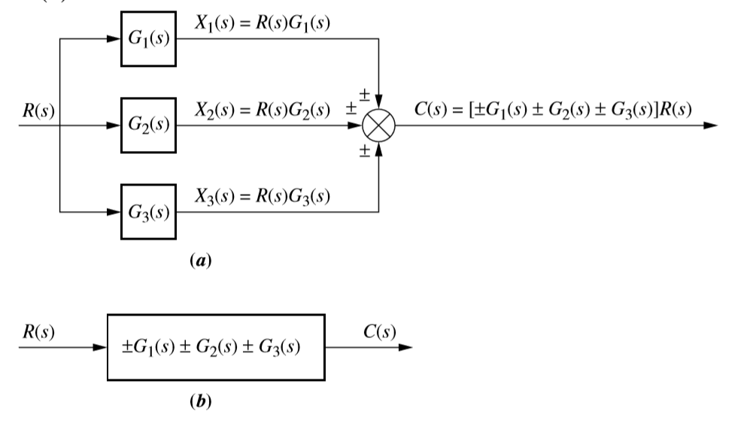
Parallel Form

Slide 6
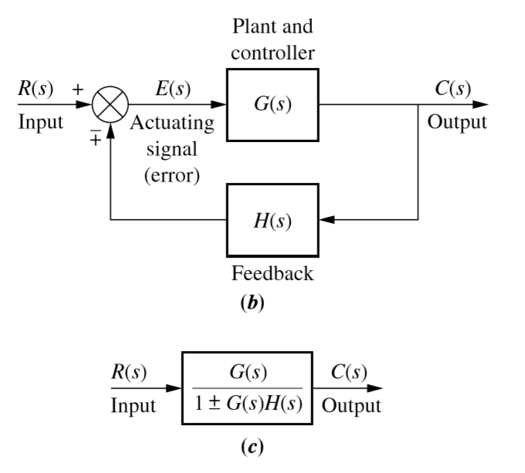
Feedback Form
The system is said to have negative feedback if the sign at the summing junction is negative and positive feedback if the sign is positive.

Slide 7
Feedback Form
The third topology is the feedback form, which will be seen repeatedly in subsequent chapters. The feedback system forms the basis for our study of control systems engineering. In Chapter 1, we defined open-loop and closed-loop systems and pointed out the advantage of closed-loop or feedback control systems over open loop systems.

Slide 8
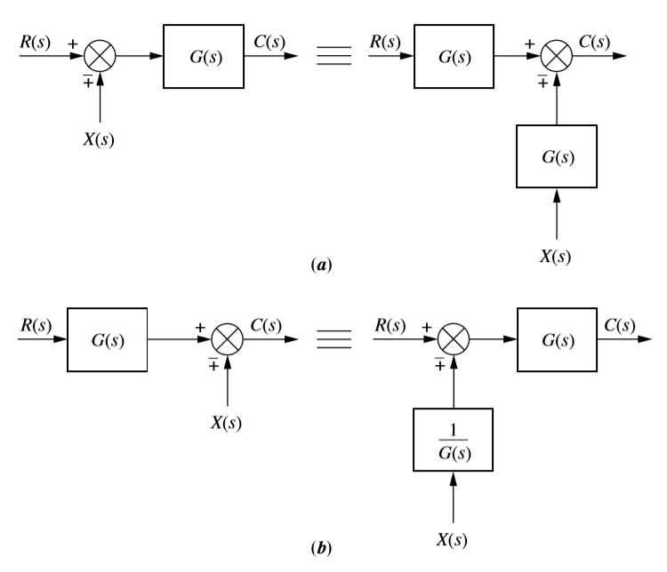
Moving Blocks to Create Familiar Form for summing junction

Slide 9
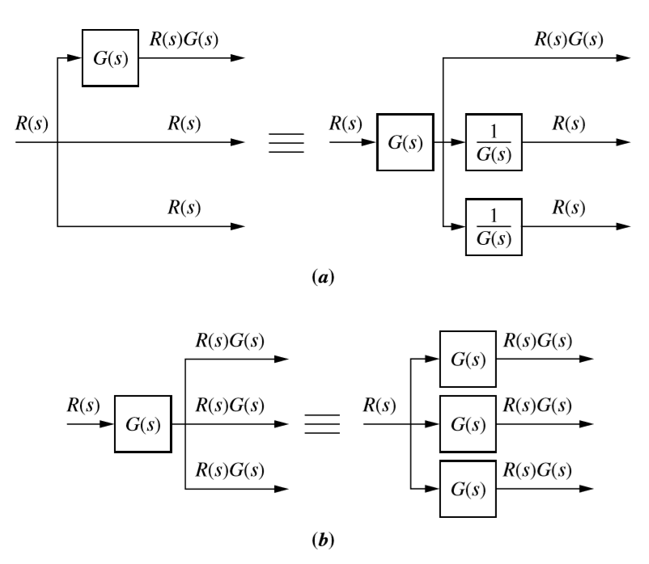
Moving Blocks to Create Familiar Form for Pick off Point

Slide 10
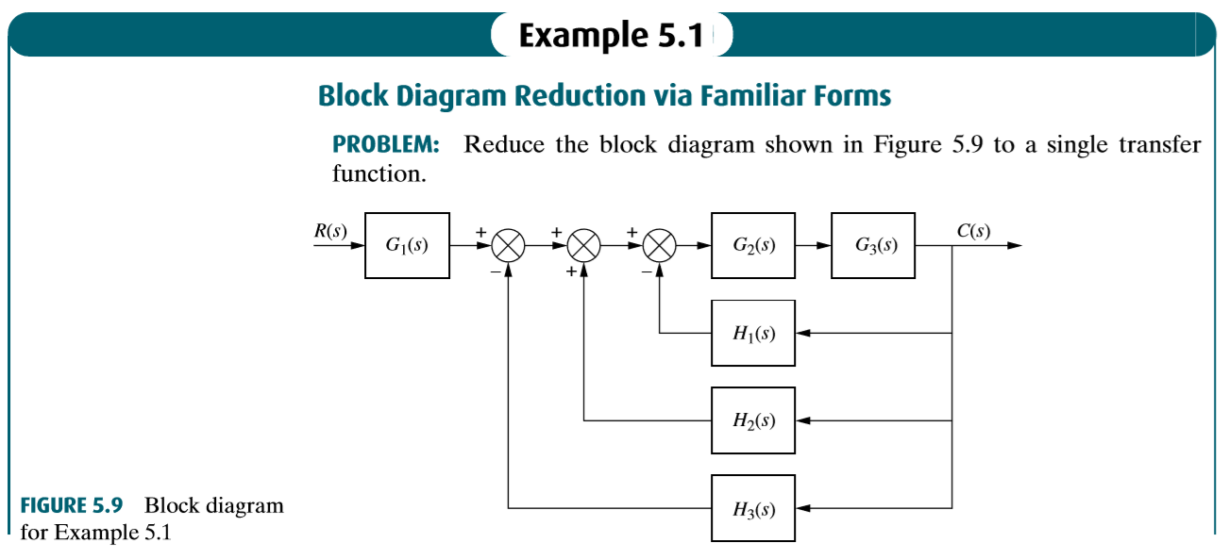

Slide 11
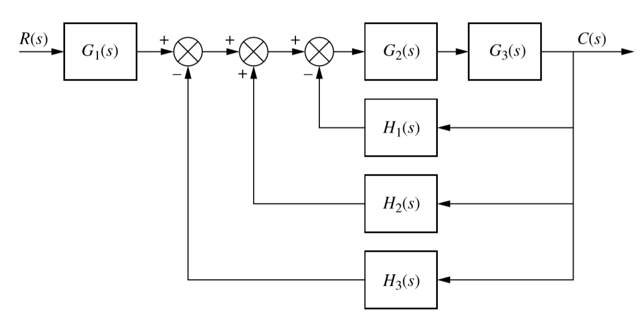
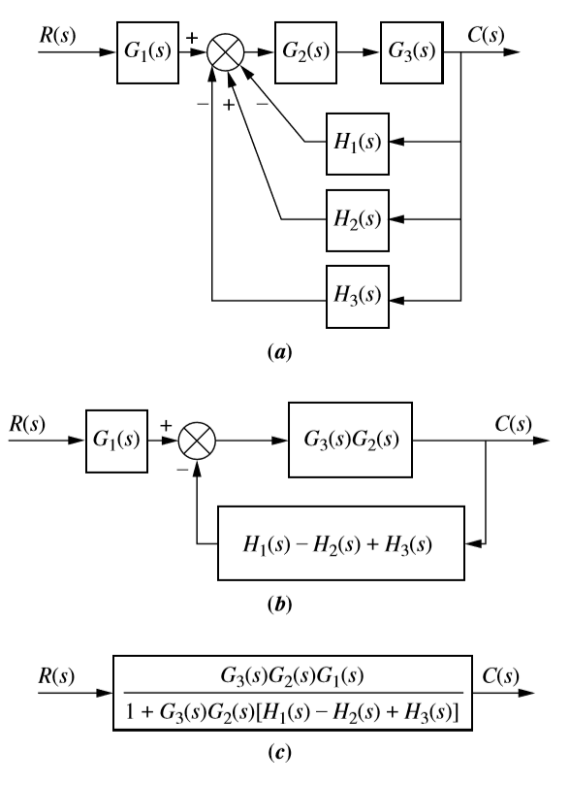

Slide 12
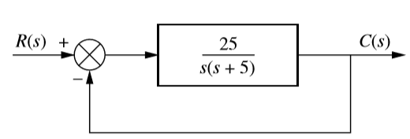
The closed-loop transfer function found from the given system find Settling Time, Peak Time and Percentage Overshoot

Slide 13
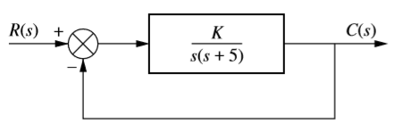
Design the value of gain K, for the feedback control system so that the system will respond with a 10% overshoot.

Slide 14
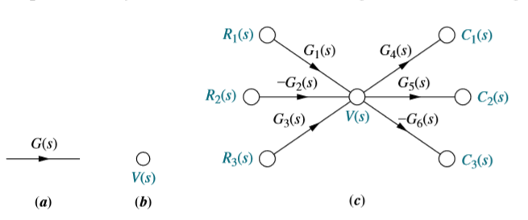
Signal Flow Graph (SFG)
Signal-flow graphs are an alternative to block diagrams. Unlike block diagrams, which consist of blocks, signals, summing junctions, and pickoff points, a signal-flow graph consists only of branches, which represent systems and nodes, which represent signals.

Slide 15
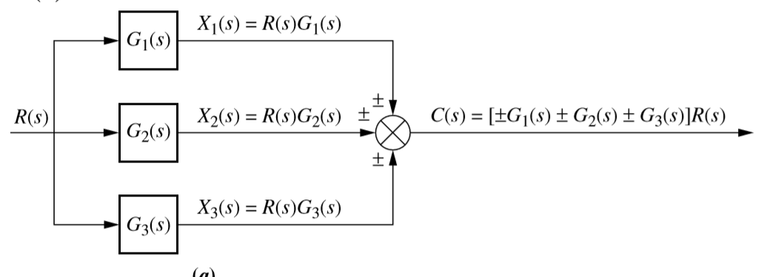
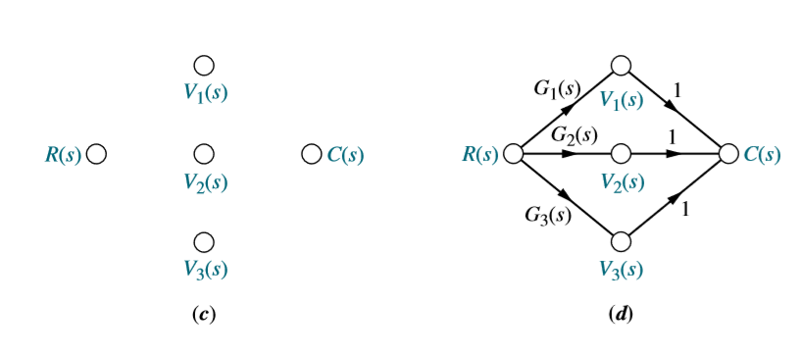

Slide 16
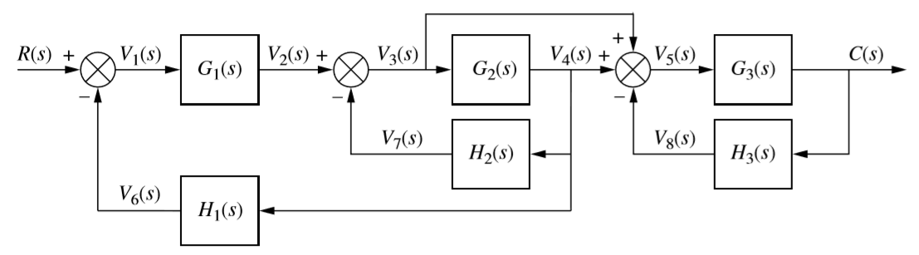
Convert the given Block Diagram into SFG

Slide 17

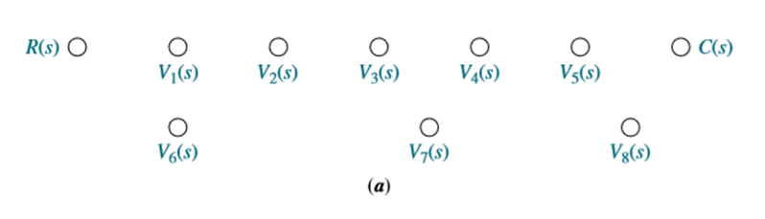

Slide 18

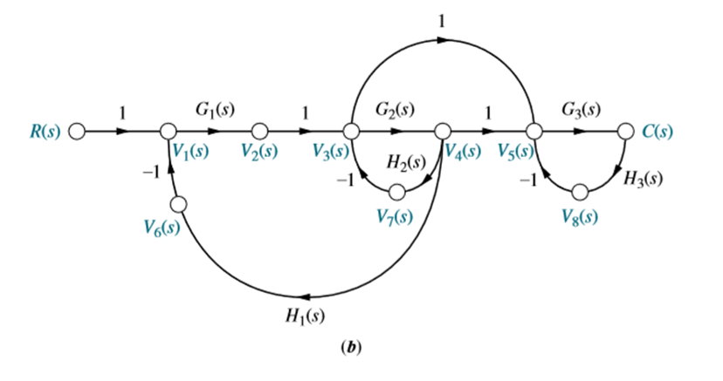
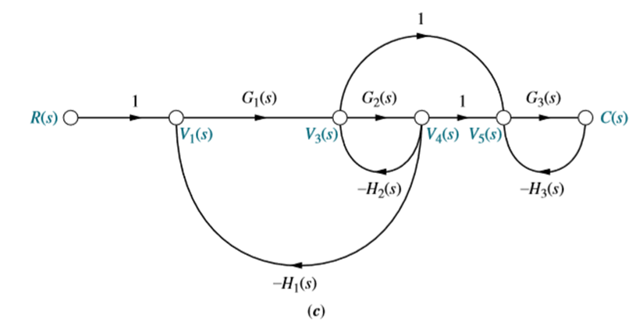


Slide 19
Mason’s Rule
A technique for reducing signal-flow graphs to single transfer functions that relate the output of a system to its input.
Mason’s rule for reducing a signal-flow graph to a single transfer function requires the application of one formula.
The formula was derived by S. J. Mason when he related the signal-flow graph to the simultaneous equations that can be written from the graph (Mason, 1953).

Slide 20
Mason’s Formula Components
Loop gain
Forward-path gain
Non touching loops

Slide 21
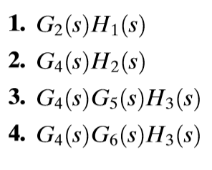
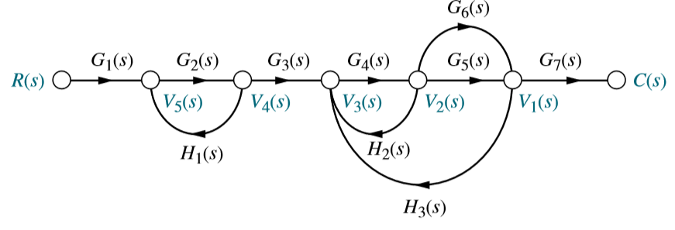
Loop gain
The product of branch gains found by traversing a path that starts at a node and ends at the same node, following the direction of the signal flow, without passing through any other node more than once. For examples of loop gains, see Figure. There are four loop gains:

Slide 22
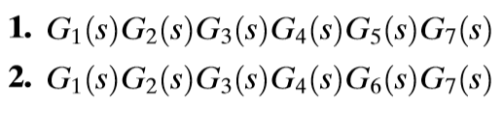
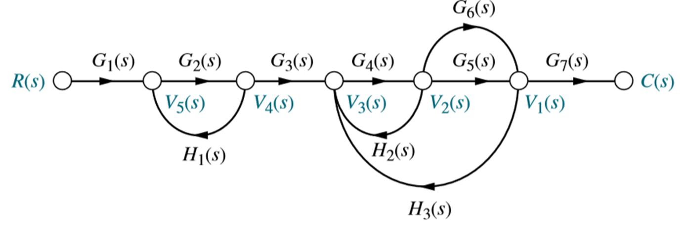
Forward-path gain
The product of gains found by traversing a path from the input node to the output node of the signal-flow graph in the direction of signal flow. There are two forward-path gains:

Slide 23
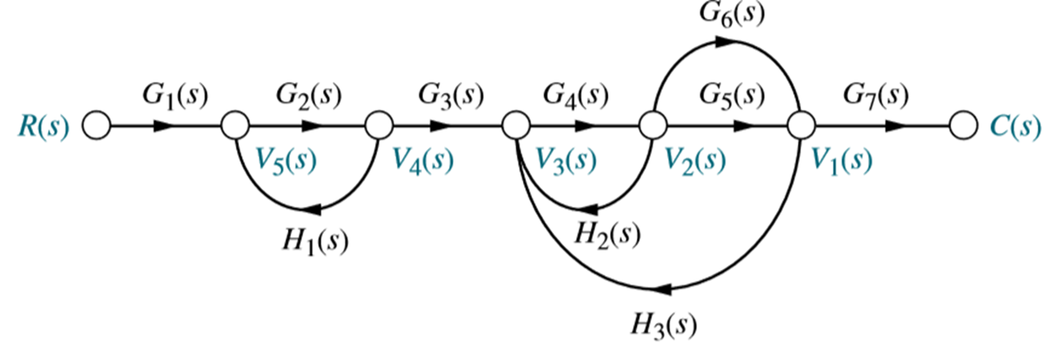
Non touching Loop
Loops that do not have any nodes in common. In this figure loop G2(s)H1(s) does not touch loops G4(s)H2(s), G4(s)G5(s)H3(s) and G4(s)G6(s)H3(s).

Slide 24
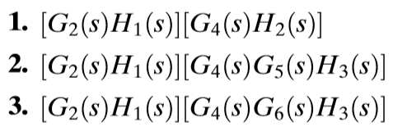
Non touching Loop Gain
The product of loop gains from non touching loops taken two, three, four or more at a time. For example the product of loop gain G2(s)H1(s) and loop gain G4(s)H2(s) is a non touching-loop gain taken two at a time. In summary, all three of the non touching-loop gains taken two at a time are:

Slide 25
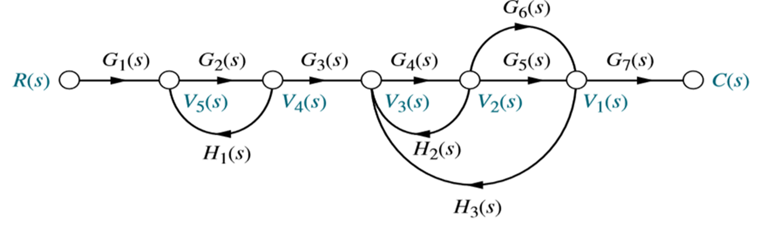
The product of loop gains G4(S)G5(S)H3(S) and G4(S)G6(S)H3(S) is not a non touching loop gain since these two loops have nodes in common. In our example there are no non touching-loop gains taken three at a time since three non touching loops do not exist in the example.

Slide 26
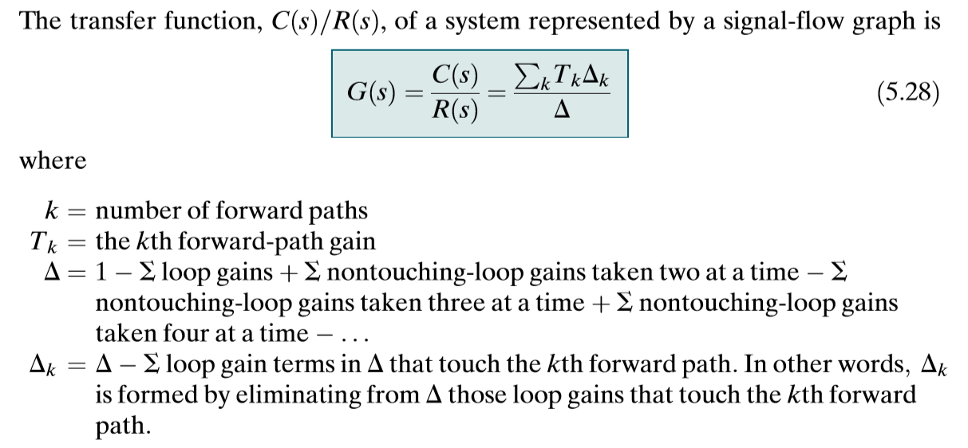
Mason’s Formula
Correction in Δk $∆_{k}=1−loop gain which does not touch the forward path$

Slide 27
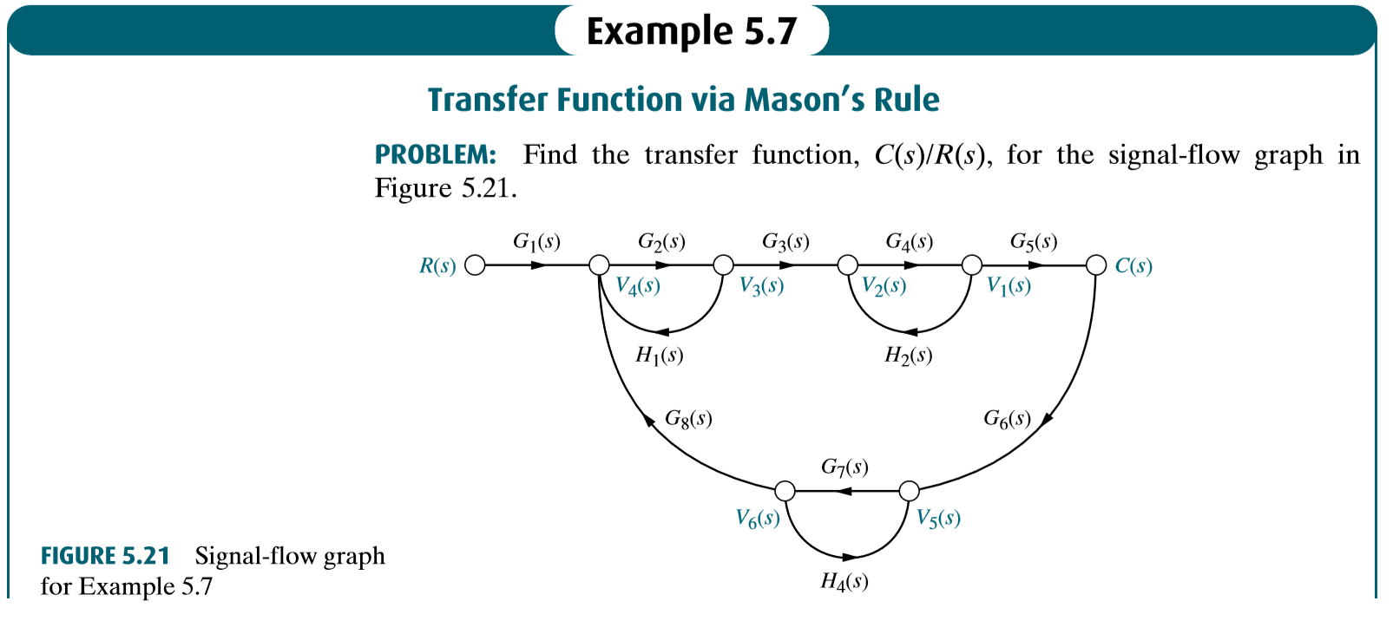

Slide 28
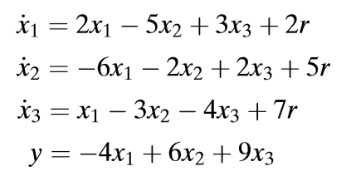
Signal-Flow Graphs of State Equations
Consider the following state and output equations:

Slide 29
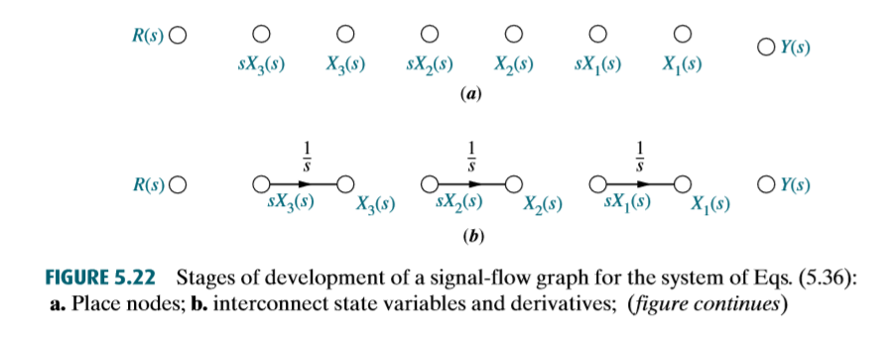
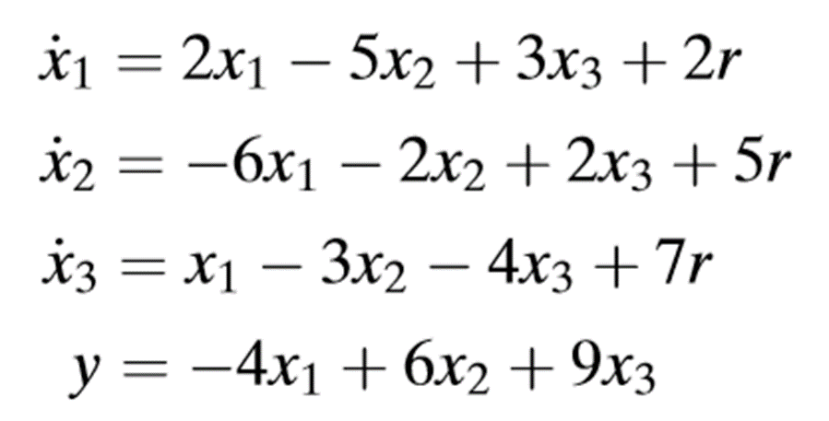
Stages of development of a signal-flow graph for the system

Slide 30
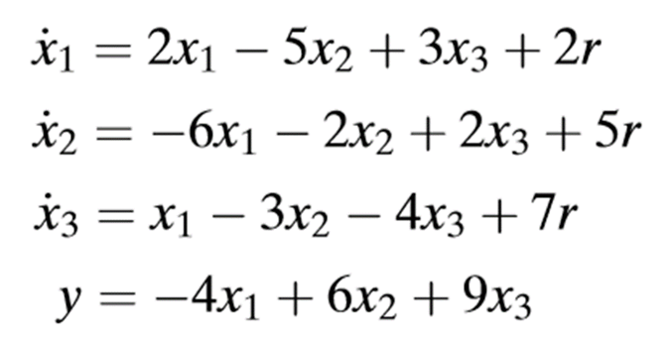
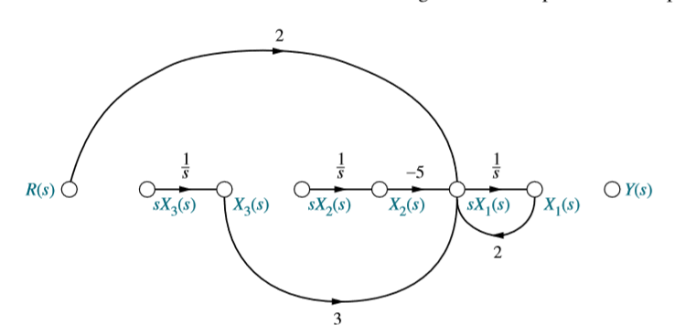

Form $\frac{dx1}{dt}$ ……….continued

Slide 31
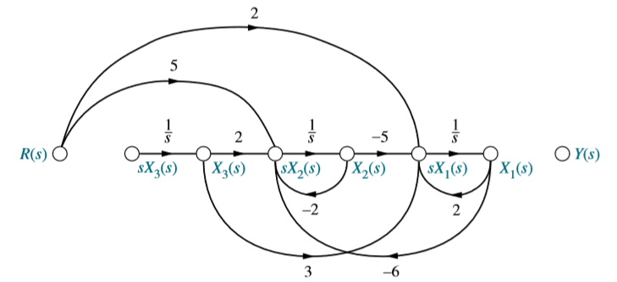

Form $\frac{dx2}{dt}$ ……….continued

Slide 32
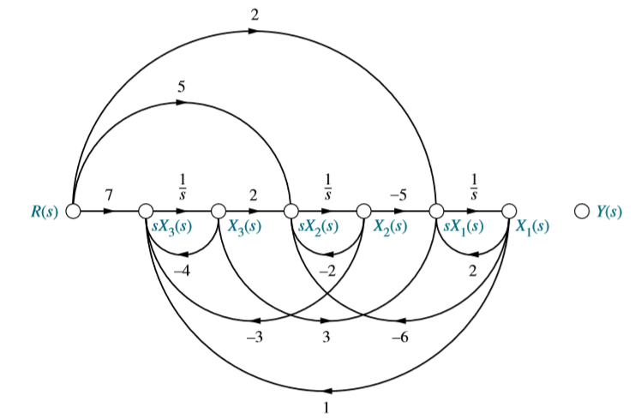

Form $\frac{dx3}{dt}$ ……….continued

Slide 33
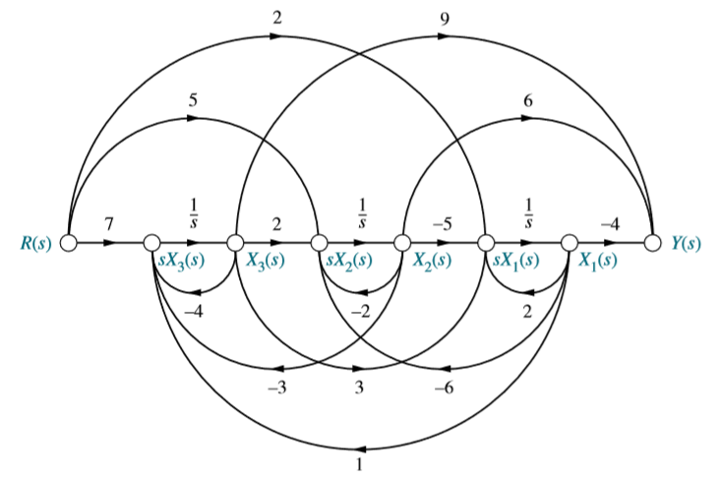
Finally Form with Output y

